Slide 1
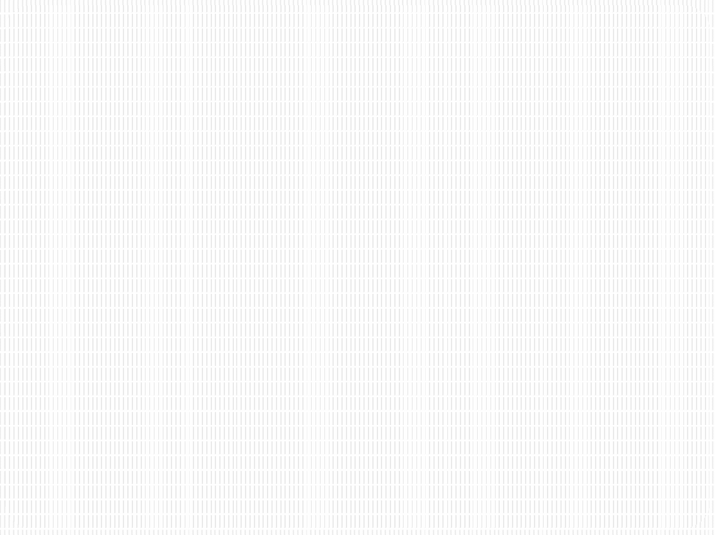


SRM INSTITUTE OF SCIENCE AND TECHNOLOGY
18CSC201J – Data Structures and Algorithms
Unit III- STACK & QUEUE

Slide 2
SESSION 6

Slide 3
Applications of Stack: Function Call and Return
2 types of Memory
Stack
Heap
Stack memory stores the data (variables) related to each function.
Why is it called stack memory?
The last function to be called is the first to return (LIFO)
The data related to a function are pushed into the stack when a function is called and popped when the function returns

Slide 4
Nested Function Calls
Consider the code snippet below:
main()
{
...
foo();
bar();
}
foo()
{
...
bar();
...
}
bar()
{
...
}

Slide 5
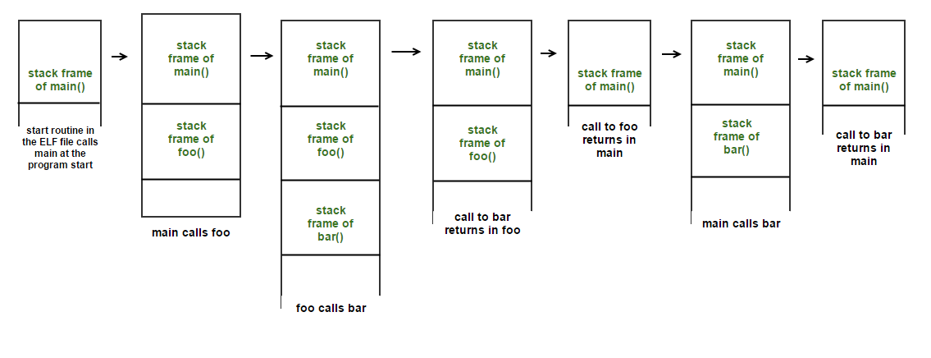
Nested Function Calls and Returns in Stack Memory
Stack memory when the code executes:
Direction of Stack growth
Image Source: https://loonytek.com/2015/04/28/call-stack-internals-part-1/

Slide 6
Function Call and Return in Stack Memory
Each call to a function pushes the function’s activation record (or stack frame) into the stack memory
Activation record mainly consists of: local variables of the function and function parameters
When the function finishes execution and returns, its activation record is popped

Slide 7
Recursion
A recursive function is a function that calls itself during its execution.
Each call to a recursive function pushes a new activation record (a.k.a stack frame) into the stack memory.
Each new activation record will consist of freshly created local variables and parameters for that specific function call.
So, even though the same function is called multiple times, a new memory space will be created for each call in the stack memory.

Slide 8
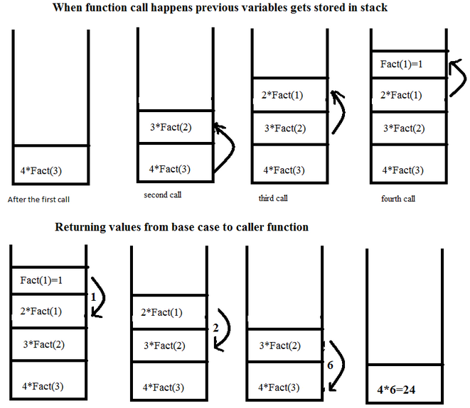
Recursion Handling by Stack Memory
Factorial program
int fact( int n)
{
if (n==1)
return 1;
else
return (n*fact(n-1));
}
fact(4);
Direction of Stack growth
Image Source: https://stackoverflow.com/questions/19865503/can-recursion-be-named-as-a-simple-function-call

